Slide 1
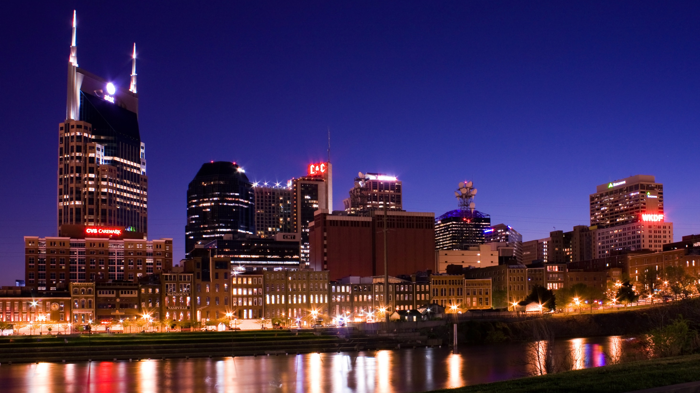
Being God’s People
In Today’s World
Notes:
1. Welcome 2. Shepherd Introductions
3. Announcements 4. Prayer

Slide 2
Overview
Week 1 Establish our response to God’s plan for humanity
Week 2 Examine NT snapshots of offering grace and love to others
Week 3 Examine contemporary case studies to be faithful to God’s plan and live with grace and love to others

Slide 3
Aim for this class series:
To help OC engage a turbulent culture with faithfulness and grace.
Aim for today:
To consider how we can live faithfully and with grace in the world in relation to our sexual integrity and our civil conversation.

Slide 4
Being God’s People
In Today’s World
Faithful to His Will

Slide 5
Review
Week 1: Responding Faithfully to the Will of God
Turbulence and brokenness seem to be everywhere in the world today.
The will of God is sovereign.
As God’s people we must remain faithful.
Our faithfulness is our witness to the world.
Notes:
This fourth point will be our focus today: How can we live with grace for the people around us and be faithful to the will of God. We will consider four case studies from the NT.

Slide 6
Review
Week 2: Living with Grace in the World
We remembered these four snapshots:
1. The Samaritan Woman at the Well
2. The Woman Caught in Adultery
3. The Jerusalem Council
4. Paul in Athens

Slide 7
Review
Week 2: Living with Grace in the World
We noted these trends:
Claiming moral superiority is not becoming of a Jesus follower.
Grace requires listening well.
Forgiveness and grace always trump legalism.
We should not erect barriers for those turning to God.
God’s truth remains intact.

Slide 8
Review
Week 2: Living with Grace in the World
We are called to offer love and grace to the world around us.
Our witness to the world is limited by our ability to show love and grace.

Slide 9
Being God’s People
In Today’s World
Faithful to His Will

Slide 10
Turbulence in the World Today
Outrage vs. Persuasion, lack of civility
Red vs. Blue Polarization
Violence in our cities (i.e. Chicago, Nashville)
Mass shootings
Sexual abuse / violence
Sexual scandals in leadership of Protestant/Catholic churches
Other examples?
Notes:
From week 1 we noted these areas of turbulence in the world that can be divided into two themes

Slide 11
Turbulence in the World Today
Outrage / Lack of Civility
Outrage vs. Persuasion, lack of civility
Red vs. Blue Polarization
Violence in our cities (i.e. Chicago, Nashville)
Mass shootings
Sexual abuse / violence
Sexual scandals in leadership of Protestant/Catholic churches
Other examples?
Sexual Integrity
Notes:
From week 1 we noted these areas of turbulence in the world that can be divided into two themes

Slide 12
A Pastoral Word on Sexual Integrity
James 4:10
Humble yourselves before the Lord, and he will lift you up.
Notes:
On behalf of the elders, express that we are approaching this topic with humility because we recognize that none of us are perfect. We confess the church's complicity in the brokenness of our marriages, including divorce, and seek to renew our passion to honor God in all relationships.
We are not approaching these topics as a lecture. We want the church to know how the elders are approaching these issues in our own lives and we want to invite you to follow.

Slide 13
A Pastoral Word on Sexual Integrity
The Value of Persons and Marriage
All people bear the image of God.
Notes:
The lack of sexual integrity is rooted in a devaluing of persons and marriage. OC shepherds value people and the relationship of marriage.
1. We believe all humans are created in the image of God and all, regardless of their attraction/sexual identity, reflect the glory of God.
2. Otter Creek welcomes all on our journey to be Jesus followers.
3. We view marriage as a sacrament administered by the church.

Slide 14
A Pastoral Word on Sexual Integrity
The Value of Persons and Marriage
All people bear the image of God.
Genesis 1:27
So God created mankind in his own image,
in the image of God he created them;
male and female he created them.
Notes:
The lack of sexual integrity is rooted in a devaluing of persons and marriage. OC shepherds value people and the relationship of marriage.
1. We believe all humans are created in the image of God and all, regardless of their attraction/sexual identity, reflect the glory of God.
2. Otter Creek welcomes all on our journey to be Jesus followers.
3. We view marriage as a sacrament administered by the church.

Slide 15
A Pastoral Word on Sexual Integrity
The Value of Persons and Marriage
All people bear the image of God.
Because we are all made in the image of God, Otter Creek welcomes all on our journey to be Jesus followers.
We understand that marriage is a holy, covenantal relationship.
Notes:
The lack of sexual integrity is rooted in a devaluing of persons and marriage. OC shepherds value people and the relationship of marriage.
1. We believe all humans are created in the image of God and all, regardless of their attraction/sexual identity, reflect the glory of God.
2. Otter Creek welcomes all on our journey to be Jesus followers.
3. We view marriage as a sacrament administered by the church.

Slide 16
A Pastoral Word on Sexual Integrity
The Nature of Sexual Integrity
From scripture, the history of the church, and from our own communal discernment wisdom, we discern that Jesus followers are called to practice sexual integrity.
Matthew 5:27-28
“You have heard that it was said, ‘You shall not commit adultery.’ But I tell you that anyone who looks at a woman lustfully has already committed adultery with her in his heart.
Notes:
What sexual integrity looks like.
God desires that all practice sexual integrity.
While recognizing that Christians hold different views on this subject and we continue to study scripture and seek God’s will, Otter Creek holds to the traditional teaching of our Judeo-Christian heritage that marriage and sexual intimacy are intended to be a gift between a man and a woman.
For the sake of sexual integrity, we encourage non-married followers to pursue God’s plan for celibacy outside of marriage.
If questions about a specific person's sexual integrity arise, issues related to membership and leadership roles will be decided by the Shepherds.

Slide 17
A Pastoral Word on Sexual Integrity
The Nature of Sexual Integrity
From scripture, the history of the church, and from our own communal discernment wisdom, we discern that Jesus followers are called to practice sexual integrity.
We recognize reasonable Christians have differing views on this issue but we believe sex is reserved for marriage between a man and a woman.
Notes:
What sexual integrity looks like.
God desires that all practice sexual integrity.
While recognizing that Christians hold different views on this subject and we continue to study scripture and seek God’s will, Otter Creek holds to the traditional teaching of our Judeo-Christian heritage that marriage and sexual intimacy are intended to be a gift between a man and a woman.
For the sake of sexual integrity, we encourage non-married followers to pursue God’s plan for celibacy outside of marriage.
If questions about a specific person's sexual integrity arise, issues related to membership and leadership roles will be decided by the Shepherds.

Slide 18
A Pastoral Word on Sexual Integrity
The Nature of Sexual Integrity
This means we are all called to the (sometimes difficult) practice of celibacy outside of marriage.
In our authentic pursuit of Christlikeness we want to develop a culture of transparency and accountability around sexual integrity at OC.
Notes:
What sexual integrity looks like.
God desires that all practice sexual integrity.
While recognizing that Christians hold different views on this subject and we continue to study scripture and seek God’s will, Otter Creek holds to the traditional teaching of our Judeo-Christian heritage that marriage and sexual intimacy are intended to be a gift between a man and a woman.
For the sake of sexual integrity, we encourage non-married followers to pursue God’s plan for celibacy outside of marriage.
If questions about a specific person's sexual integrity arise, issues related to membership and leadership roles will be decided by the Shepherds.

Slide 19
A Pastoral Word on Sexual Integrity
Best Practices
The importance of sexual integrity cannot be overstated (Mark 7:21, 1 Cor. 6:18).
Flee from the appearance of impropriety in the workplace.
Use your influence to encourage sexual integrity in others.
Avoid entertainment / media that induces sexual thought or desensitizes you to sexual sin.
Notes:
See Mark 7:21, 1 Cor 6:18
Flee!
(i.e. sexual sensitivity training at work, take measures to increase self-awareness in others, etc.)
If you are married, invest in your marriage (Grace Marriage is a fantastic way to do this.)

Slide 20
Being God’s People
In Today’s World
Faithful to His Will

Slide 21
A Pastoral Word on Civil Discourse
The Cycle of Outrage
Outrage is fed by mob mentality.
Expressing outrage does not alleviate outrage, in fact it incites it.
Once outrage has been expressed counter-outrage immediately begins to build, and the cycle continues

Slide 22
A Pastoral Word on Civil Discourse
Amplification of Outrage by Technology
Biased media builds the mobs.
24 hour news cycle incites and accelerates the outrage cycle.
Social media provides the forum for outrage and counter-outrage to build.

Slide 23
A Pastoral Word on Civil Discourse
A Word from Ephesians
Ephesians 4:1-6
How can we train ourselves to speak to one another within the church in truth and love?
How do we maintain the unity of the Spirit when we disagree about something?

Slide 24
A Pastoral Word on Civil Discourse
A Word from Ephesians
Ephesians 4:11-16, 29
What does it mean to speak the truth in love?
How is the church and the mission of God affected in the world when Christians treat one another poorly?

Slide 25
A Pastoral Word on Civil Discourse
Best Practices
1 Corinthians 10:23-24
Notes:
Note this is included in OCC’s Social Networking/Communication policy for OC’s leadership.
Discussion: When we disagree, what is the best way to resolve our differences?
Discussion: How does the degree of your certainty help or hinder your point of view on a matter?
From SM Policy: Remember that written words can easily convey the wrong message. Written words do not have the “non-verbal” channels that accompany face-to-face communication.
From SM Policy: If a public dialog gets heated, stop using a public forum and make the conversation private (Matthew 18:15-17).

Slide 26
A Pastoral Word on Civil Discourse
Social Media Policy for OC Leadership
Ensuring Integrity
Your electronic communications should be consistent with the teaching of the scripture and the values of OCC. Do not say anything online that you wouldn’t say in person as a representative of the church (Proverbs 10:9).
Notes:
Note this is included in OCC’s Social Networking/Communication policy for OC’s leadership.
Discussion: When we disagree, what is the best way to resolve our differences?
Discussion: How does the degree of your certainty help or hinder your point of view on a matter?
From SM Policy: Remember that written words can easily convey the wrong message. Written words do not have the “non-verbal” channels that accompany face-to-face communication.
From SM Policy: If a public dialog gets heated, stop using a public forum and make the conversation private (Matthew 18:15-17).

Slide 27
A Pastoral Word on Civil Discourse
Best Practices
1 Corinthians 10:23-24
Resolve differing opinions lovingly.
Listen well and do not hold tightly to your view.
Be cautious how you engage on social media.
Notes:
Note this is included in OCC’s Social Networking/Communication policy for OC’s leadership.
Discussion: When we disagree, what is the best way to resolve our differences?
Discussion: How does the degree of your certainty help or hinder your point of view on a matter?
From SM Policy: Remember that written words can easily convey the wrong message. Written words do not have the “non-verbal” channels that accompany face-to-face communication.
From SM Policy: If a public dialog gets heated, stop using a public forum and make the conversation private (Matthew 18:15-17).

Slide 28
A Pastoral Word on Civil Discourse
Social Media Policy for OC Leadership
Limited Expression in Written Words
Remember that written words can easily convey the wrong message. Written words do not have the “non-verbal” channels that accompany face-to-face communication.
Notes:
Note this is included in OCC’s Social Networking/Communication policy for OC’s leadership.
Discussion: When we disagree, what is the best way to resolve our differences?
Discussion: How does the degree of your certainty help or hinder your point of view on a matter?
From SM Policy: Remember that written words can easily convey the wrong message. Written words do not have the “non-verbal” channels that accompany face-to-face communication.
From SM Policy: If a public dialog gets heated, stop using a public forum and make the conversation private (Matthew 18:15-17).

Slide 29
A Pastoral Word on Civil Discourse
Best Practices
1 Corinthians 10:23-24
Resolve differing opinions lovingly.
Listen well and do not hold tightly to your view.
Be cautious how you engage on social media.
Try to move digital conversations to face to face interactions.
Notes:
Note this is included in OCC’s Social Networking/Communication policy for OC’s leadership.
Discussion: When we disagree, what is the best way to resolve our differences?
Discussion: How does the degree of your certainty help or hinder your point of view on a matter?
From SM Policy: Remember that written words can easily convey the wrong message. Written words do not have the “non-verbal” channels that accompany face-to-face communication.
From SM Policy: If a public dialog gets heated, stop using a public forum and make the conversation private (Matthew 18:15-17).

Slide 30
A Pastoral Word on Civil Discourse
Social Media Policy for OC Leadership
Ensuring Integrity
If a public dialog gets heated, stop using a public forum and make the conversation private (Matthew 18:15-17).
Notes:
Note this is included in OCC’s Social Networking/Communication policy for OC’s leadership.
Discussion: When we disagree, what is the best way to resolve our differences?
Discussion: How does the degree of your certainty help or hinder your point of view on a matter?
From SM Policy: Remember that written words can easily convey the wrong message. Written words do not have the “non-verbal” channels that accompany face-to-face communication.
From SM Policy: If a public dialog gets heated, stop using a public forum and make the conversation private (Matthew 18:15-17).

Slide 31
A Pastoral Word on Civil Discourse
Best Practices
1 Corinthians 10:23-24
Resolve differing opinions lovingly.
Listen well and do not hold tightly to your view.
Be cautious how you engage on social media.
Try to move digital conversations to face to face interactions.
Notes:
Note this is included in OCC’s Social Networking/Communication policy for OC’s leadership.
Discussion: When we disagree, what is the best way to resolve our differences?
Discussion: How does the degree of your certainty help or hinder your point of view on a matter?
From SM Policy: Remember that written words can easily convey the wrong message. Written words do not have the “non-verbal” channels that accompany face-to-face communication.
From SM Policy: If a public dialog gets heated, stop using a public forum and make the conversation private (Matthew 18:15-17).

Slide 32
Living with Grace in the World
Conclusion
The OC Shepherds encourage you as people of God to live faithfully to God’s will and with grace in the world.

Slide 33
Being God’s People
In Today’s World
Faithful to His Will

